Slide 1
REACT NATIVE
Lesson 4: GraphQL

Slide 2

GraphQL
Tab Navigation
Icons
SectionList
https://cloud.hasura.io/

Slide 3
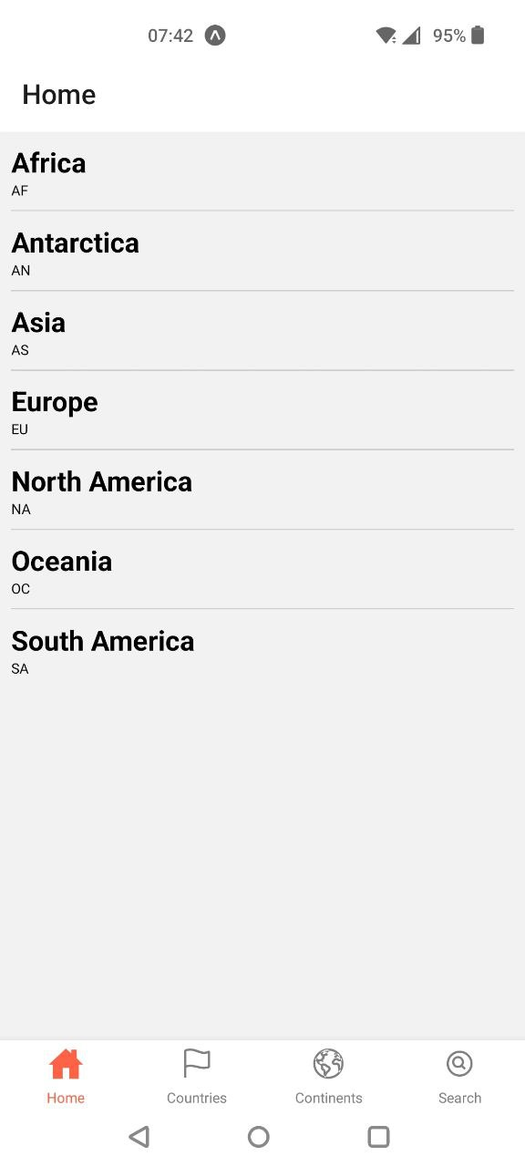
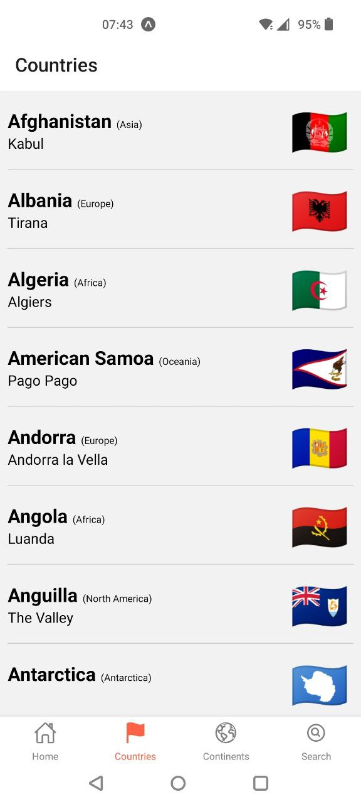
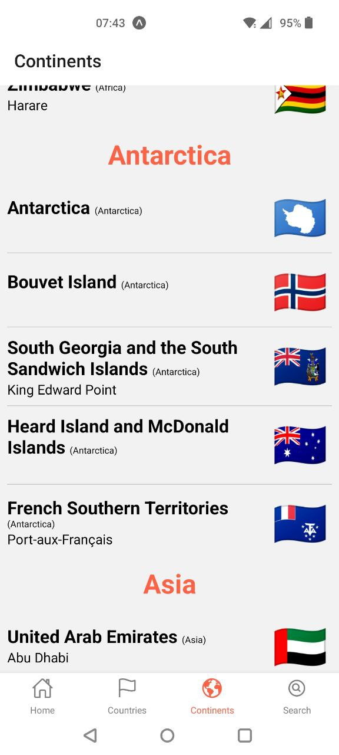
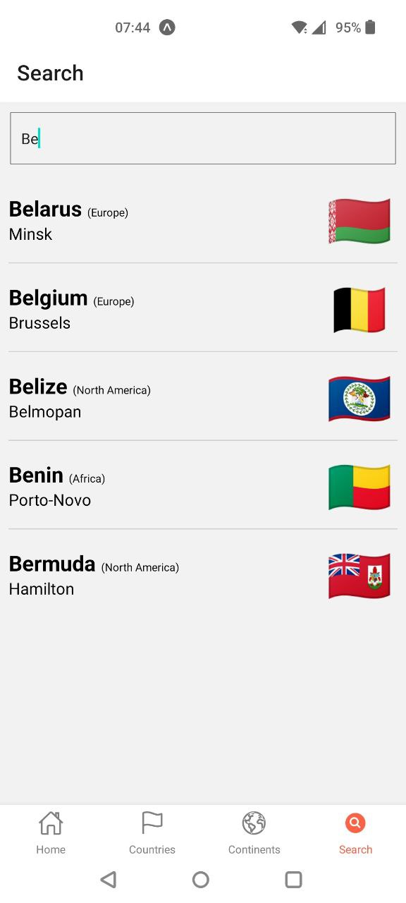
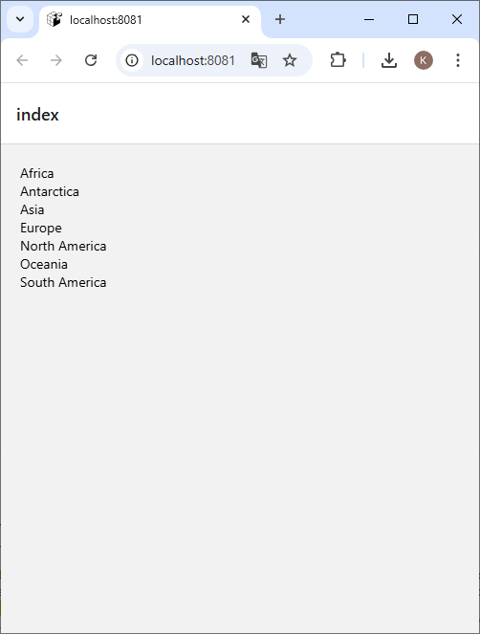
Our Goal

Slide 4
GraphQL
npx create-expo-app@latest lesson4
npm run reset-project
npm install @apollo/client graphql
Delete index.tsx
Copy Resources
npx expo start

Slide 5
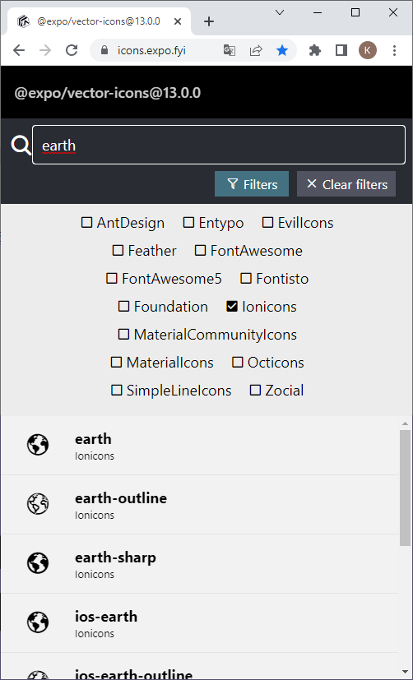
Tab navigation
npm install @react-navigation/bottom-tabs
npm install @expo/vector-icons
https://icons.expo.fyi/

Slide 6
Tab Navigation
Possibly the most common style of navigation in mobile apps.
On the bottom of the screen or on the top.
Use createBottomTabNavigator to create a new Bottom Tab.
Tab.Navigator should contain Tab.Screen elements as its children for every Tab.

Slide 7
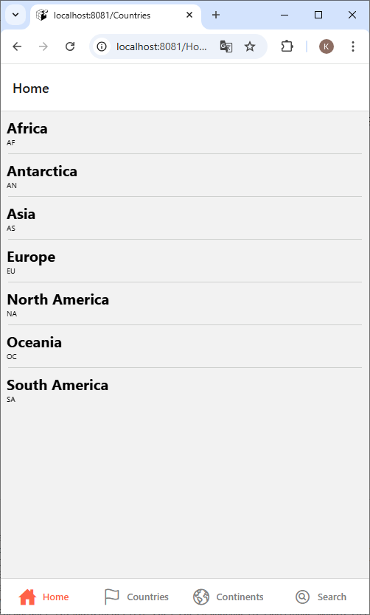
index.jsx

Slide 8
React ⇨ Components
export default function Error({ error }) {
return (
<Text style={styles.error}>Error! {error.message}</Text>
);
};
export default function Fetching() {
return (
<Text style={styles.loading}>Fetching data...</Text>
);
};
export default function Separator() {
return (
<View
style={styles.line}
/>
);
};

Slide 9
Countries
https://hasura.io/docs/2.0/queries/postgres/simple-object-queries/

Slide 10
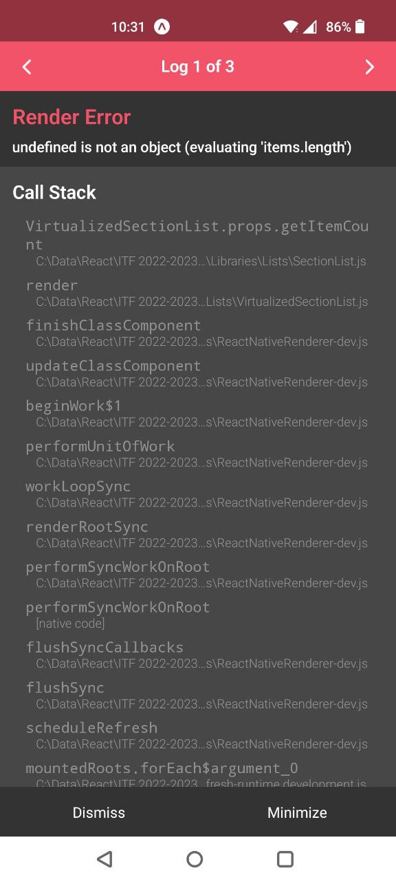
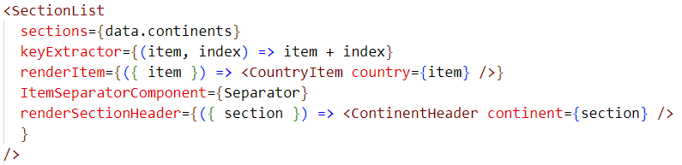
Continents

Slide 11
Sectionlist
A performant interface for rendering sectioned lists with header, footer, separator, …
Place your info in the sections property.
renderSectionHeader will be rendered for every section (i.e. every title).
Items (i.e. dishes) in the data property!
const info = [
{ title: "Main dishes",
data: ["Pizza", "Burger", "Risotto"] },
{ title: "Sides",
data: ["French Fries", "Onion Rings", "Fried Shrimps"] },
{ title: "Drinks",
data: ["Water", "Coke", "Beer"] },
{ title: "Desserts",
data: ["Cheese Cake", "Ice Cream"] } ];

Slide 12
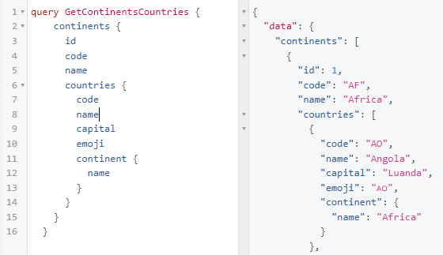
How can we make it work?
<SectionList
sections={data.continents}
keyExtractor={(item, index) => item + index}
renderItem={({ item }) => <CountryItem country={item} />}
ItemSeparatorComponent={Separator}
renderSectionHeader={({ section }) => <ContinentHeader continent={section} /> }
/>

Slide 13
Search
https://www.apollographql.com/docs/react/data/queries/#manual-execution-with-uselazyquery

